Slide 1
Transport Layer

Slide 2
Introduction
The transport layer is the fourth layer in the OSI model and the second layer in the TCP/IP model.
The transport layer provides with end to end connection between the source and the destination and reliable delivery of the services.
Therefore transport layer is known as the end-to-end layer.
The transport layer takes the services from its upward layer which is the application layer and provides it to the network layer.
Segment is the unit of data encapsulation at the transport layer.

Slide 3
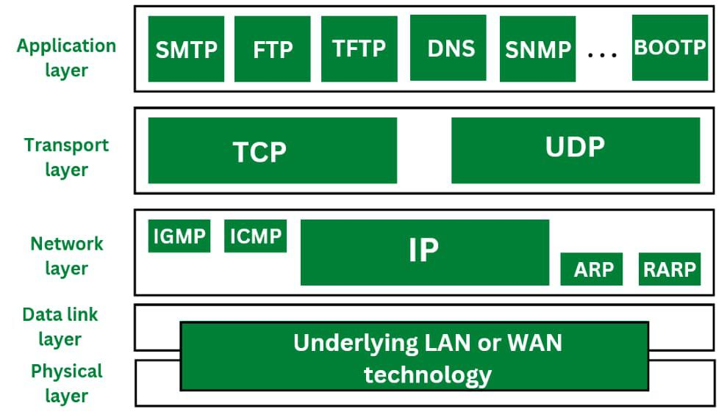

Slide 4
Cont..
Functions/Elements of Transport Layer
The process to process delivery
End-to-end connection between devices
Multiplexing and Demultiplexing
Data integrity and error Correction
Congestion Control
Flow Control

Slide 5
Cont..
Characteristics of Transport Layer Protocol
The two protocols that make up the transport layer are TCP and UDP.
A datagram is sent by the IP protocol at the network layer from a source host to a destination host.
These days, an operating system can support environments with multiple users and processes; a programme under execution is referred to as a process.
A source process is transmitting a process to a destination process when a host sends a message to another host. Certain connections to certain ports, referred to as protocol ports, are defined by the transport layer protocols.
A positive integer address, consisting of 16 bits, defines each port.

Slide 6
Elements of Transport Layer Protocol
Elements of transport protocols encompass several crucial aspects that ensure efficient and reliable communication between devices over a network.
Following are elements of Transport Layer Protocol-
Addressing,
Connection establishment,
Connection release,
Flow control and buffering,
Multiplexing,
Congestion Control.

Slide 7
1.Addressing
Purpose:
Addressing in transport protocols identifies specific communication endpoints (hosts and applications) within a network. It allows data to be directed to the correct destination.
Key Points:
Port Numbers:
Definition: Port numbers are used to distinguish different services or applications running on a single host.
Range: TCP and UDP each have a range of 0 to 65,535 available for port numbers, with well-known ports (0-1023) reserved for standard services (e.g., HTTP, FTP).

Slide 8
Cont..
Socket Addressing:
Definition: Combines IP address and port number to uniquely identify a communication endpoint (socket) in a network.
Format: For TCP/IP, a socket is represented as a combination of IP address and port number (e.g., 192.168.1.1:80).
Header Fields:
TCP Header: Contains source and destination port numbers to identify the endpoints of a connection.
UDP Header: Similar port fields but used in connectionless communication.

Slide 9
2. Connection Establishment and Release:
Purpose: Establishing and releasing connections allows for reliable and orderly transmission of data between sender and receiver.
Key Points:
Connection-Oriented Protocols (e.g., TCP):
Three-Way Handshake:
SYN (Synchronize): Initiates a connection request from the sender.
SYN-ACK (Synchronize-Acknowledgment): Acknowledges the connection request and sends a confirmation.
ACK (Acknowledgment): Finalizes the connection setup and enables data transmission.
Connection Release: Uses a four-way handshake (FIN, FIN-ACK, ACK, ACK) to terminate the connection gracefully.

Slide 10
Cont..
Connectionless Protocols (e.g., UDP):
No Connection Setup: Each datagram is handled independently without establishing a dedicated connection.
No Connection Release: No formal termination process; communication ends when data exchange completes.

Slide 11
3. Flow Control:
Purpose: Regulates the rate of data transmission between sender and receiver to prevent overflow and ensure efficient utilization of network resources.
Key Points:
Sliding Window Protocol:
Definition: Allows multiple data segments to be in transit simultaneously between sender and receiver.
Sender Side: Maintains a congestion window to control the number of unacknowledged segments transmitted at any time.
Receiver Side: Adjusts the receiver window size to inform the sender about the amount of data it can accept.

Slide 12
Cont..
Buffering:
Definition: Uses buffers (memory storage) at both sender and receiver ends to temporarily hold data during transmission.
Purpose: Compensates for differences in data processing speeds between sender and receiver and accommodates variations in network conditions.

Slide 13
4. Error Handling and Retransmission:
Purpose:
Ensures reliable delivery of data by detecting errors and retransmitting lost or corrupted segments.
Key Points:
Acknowledgments (ACKs):
Definition: Sent by the receiver to confirm successful receipt of data segments.
Timeout Mechanism: If ACKs are not received within a specified timeout period, the sender assumes the segment is lost and retransmits it.
Selective Repeat and Go-Back-N ARQ:
Definitions:
Selective Repeat: Retransmits only the lost segments, minimizing retransmission overhead.
Go-Back-N: Retransmits all segments from the lost segment onward, simplifying the implementation but potentially wasting network resources.

Slide 14
Cont..
Addressing, connection establishment and release, flow control, and buffering are integral elements of transport protocols like TCP and UDP.
They ensure efficient, reliable, and secure communication between devices across networks, accommodating varying application requirements and network conditions.
By effectively managing these elements, transport protocols facilitate seamless data transmission and optimize network performance, supporting a wide range of applications and services in modern networking environments.

Slide 15
Transport Layer Protocols
The transport layer is represented majorly by TCP and UDP protocols.
This transport layer protocol provides connections to the individual ports.
These ports are known as protocol ports.
Transport layer protocols work above the IP protocols and deliver the data packets from IP serves to destination port and from the originating port to destination IP services.

Slide 16
TCP-Transmission Control Protocol
TCP stands for Transmission Control Protocol.
TCP protocol provides transport layer services to applications.
TCP protocol is a connection-oriented protocol.
A secured connection is being established between the sender and the receiver.
For a generation of a secured connection, a virtual circuit is generated between the sender and the receiver.
The data transmitted by TCP protocol is in the form of continuous byte streams.
A unique sequence number is assigned to each byte.
With the help of this unique number, a positive acknowledgment is received from receipt.
If the acknowledgment is not received within a specific period the data is retransmitted to the specified destination.

Slide 17
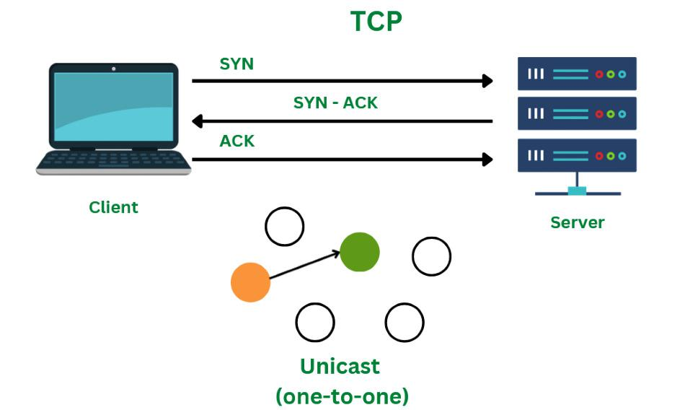

Slide 18
TCP Segment
A TCP segment's header may have 20–60 bytes.
The options take about 40 bytes.
A header consists of 20 bytes by default, although it can contain up to 60 bytes.

Slide 19
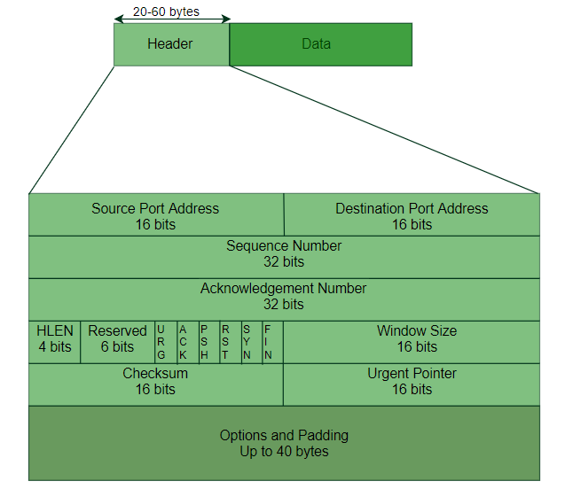

Slide 20
Cont..
Source Port Address: The port address of the programme sending the data segment is stored in the 16-bit field known as the source port address.
Destination Port Address: The port address of the application running on the host receiving the data segment is stored in the destination port address, a 16-bit field.
Sequence Number: The sequence number, or the byte number of the first byte sent in that specific segment, is stored in a 32-bit field. At the receiving end, it is used to put the message back together once it has been received out of sequence.

Slide 21
Cont..
Acknowledgement Number :
The acknowledgement number, or the byte number that the recipient anticipates receiving next, is stored in a 32-bit field called the acknowledgement number.
It serves as a confirmation that the earlier bytes were successfully received.
Header Length (HLEN):
This 4-bit field stores the number of 4-byte words in the TCP header, indicating how long the header is.
For example, if the header is 20 bytes (the minimum length of the TCP header), this field will store 5 because 5 x 4 = 20, and if the header is 60 bytes (the maximum length), it will store 15 because 15 x 4 = 60. As a result, this field's value is always between 5 and 15.

Slide 22
Cont..
Control flags: These are six 1-bit control bits that regulate flow control, method of transfer, connection abortion, termination, and establishment. They serve the following purposes:
Urgent: This pointer is legitimate
ACK: The acknowledgement number (used in cumulative acknowledgement cases) is valid.
PSH: Push request
RST: Restart the link.
SYN: Sequence number synchronisation
FIN: Cut off the communication
Window size: This parameter provides the sender TCP's window size in bytes.

Slide 23
Cont..
Checksum: The checksum for error control is stored in this field. Unlike UDP, it is required for TCP.
Urgent pointer: This field is used to point to data that must urgently reach the receiving process as soon as possible. It is only valid if the URG control flag is set. To obtain the byte number of the final urgent byte, the value of this field is appended to the sequence number.

Slide 24
Cont..
Advantages of TCP
TCP supports multiple routing protocols.
TCP protocol operates independently of that of the operating system.
TCP protocol provides the features of error control and flow control.
TCP provides a connection-oriented protocol and provides the delivery of data.

Slide 25
Cont..
Disadvantages of TCP
TCP protocol cannot be used for broadcast or multicast transmission.
TCP protocol has no block boundaries.
No clear separation is being offered by TCP protocol between its interface, services, and protocols.
In TCP/IP replacement of protocol is difficult.

Slide 26
UDP-User Datagram Protocol
UDP stands for User Datagram Protocol.
User Datagram Protocol provides a nonsequential transmission of data.
It is a connectionless transport protocol.
UDP protocol is used in applications where the speed and size of data transmitted is considered as more important than the security and reliability.
User Datagram is defined as a packet produced by User Datagram Protocol.
UDP protocol adds checksum error control, transport level addresses, and information of length to the data received from the layer above it.
Services provided by User Datagram Protocol(UDP) are connectionless service, faster delivery of messages, checksum, and process-to-process communication.

Slide 27
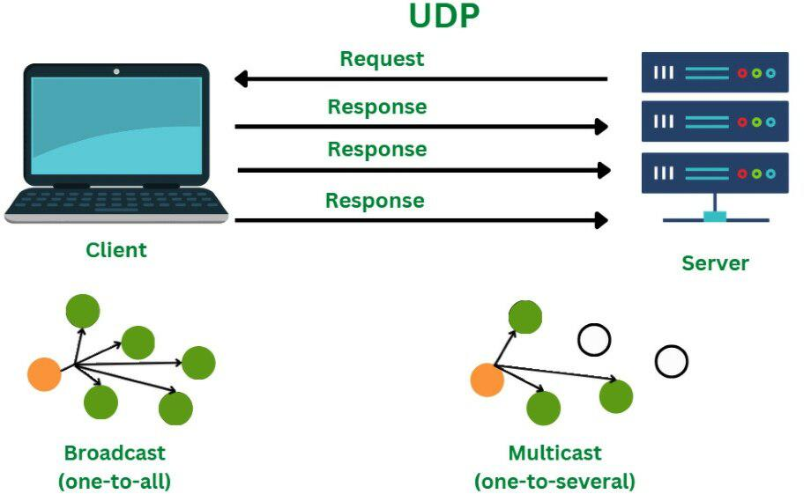

Slide 28
UDP Segment
While the TCP header can range from 20 to 60 bytes, the UDP header is a fixed, basic 8 bytes.
All required header information is contained in the first 8 bytes, with data making up the remaining portion.
Because UDP port number fields are 16 bits long, the range of possible port numbers is defined as 0 to 65535, with port 0 being reserved.

Slide 29
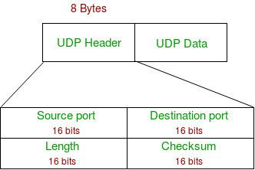

Slide 30
Cont..
Source Port: Source Port is a 2 Byte long field used to identify the port number of the source.
Destination Port: This 2-byte element is used to specify the packet's destination port.
Length: The whole length of a UDP packet, including the data and header. The field has sixteen bits.
Cheksum: The checksum field is two bytes long. The data is padded with zero octets at the end (if needed) to create a multiple of two octets. It is the 16-bit one's complement of the one's complement sum of the UDP header, the pseudo-header containing information from the IP header, and the data.

Slide 31
Cont..
Advantages of UDP
UDP also provides multicast and broadcast transmission of data.
UDP protocol is preferred more for small transactions such as DNS lookup.
It is a connectionless protocol, therefore there is no compulsion to have a connection-oriented network.
UDP provides fast delivery of messages.

Slide 32
Cont..
Disadvantages of UDP
In UDP protocol there is no guarantee that the packet is delivered.
UDP protocol suffers from worse packet loss.
UDP protocol has no congestion control mechanism.
UDP protocol does not provide the sequential transmission of data.

Slide 33
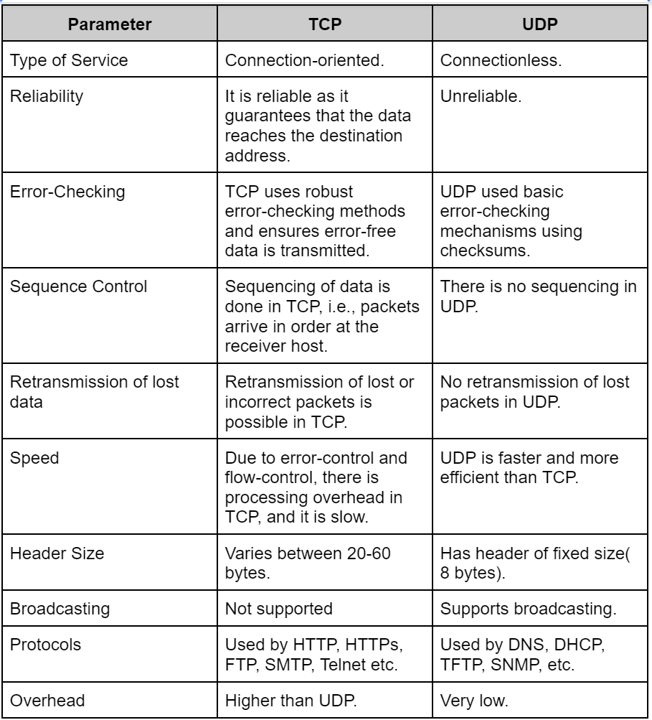

Slide 34
Real-Life Example to Understand TCP vs UDP Protocols
Consider a simple example to understand the fundamental difference between TCP & UDP protocols:
Assume two buildings, A and B. And there is a river between them. The goal is to send a letter from building A to building B. Now there are two ways to accomplish this Method 1: Build a bridge over the river and deliver the letter.
Method 2: Use a pigeon to deliver the letter.
Here, method 1 is TCP protocol where a connection is built(bridge in this example) between the two devices and then transmitted the data(letter).
Method 1 is reliable because we can directly reach the other end without any error in or loss of data.
Here method 2 is UDP as no connection is required to transmit the data(letter). UDP is faster than TCP, but it is not reliable. Because it is not guaranteed that the pigeon will go to the correct destination, the letter can be lost by the pigeon.

Slide 35
SCTP-Stream Control Transmission Protocol
SCTP stands for Stream Control Transmission Protocol.
SCTP is a connection-oriented protocol.
Stream Control Transmission Protocol transmits the data from sender to receiver in full duplex mode.
SCTP is a unicast protocol that provides with point to point-to-point connection and uses different hosts for reaching the destination.
SCTP protocol provides a simpler way to build a connection over a wireless network.
SCTP protocol provides a reliable transmission of data.

Slide 36
Cont..
SCTP provides a reliable and easier telephone conversation over the internet.
SCTP protocol supports the feature of multihoming ie. it can establish more than one connection path between the two points of communication and does not depend on the IP layer.
SCTP protocol also ensures security by not allowing the half-open connections.

Slide 37
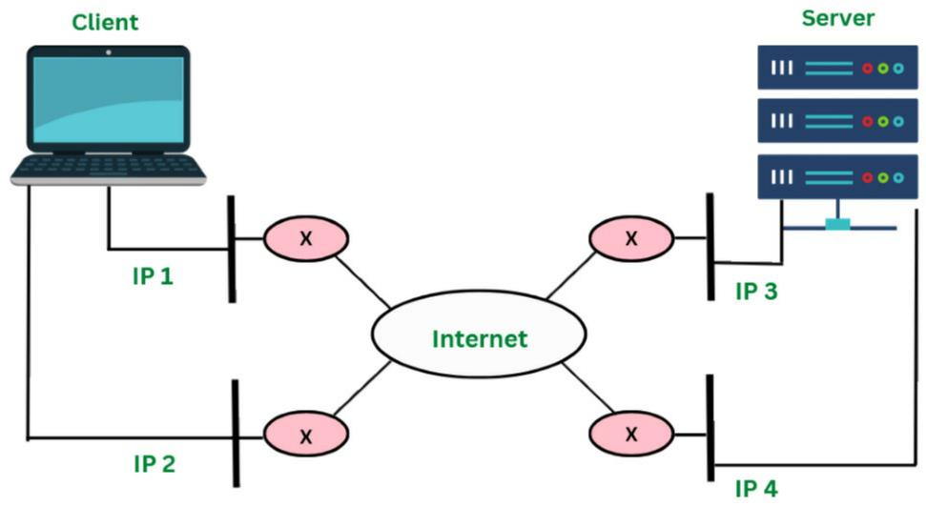

Slide 38
Cont..
Advantages of SCTP
SCTP provides a full duplex connection. It can send and receive the data simultaneously.
SCTP protocol possesses the properties of both TCP and UDP protocol.
SCTP protocol does not depend on the IP layer.
SCTP is a secure protocol.

Slide 39
Cont..
Disadvantages of SCTP
To handle multiple streams simultaneously the applications need to be modified accordingly.
The transport stack on the node needs to be changed for the SCTP protocol.
Modification is required in applications if SCTP is used instead of TCP or UDP protocol.

Slide 40
RTP-Real Time Transport Protocol
The Real-time Transport Protocol (RTP) is a network protocol for delivering audio and video over IP networks in real-time, used in applications like video conferencing, VoIP, and live streaming.
RTP handles the actual media delivery, providing features like timestamping and sequence numbering to ensure data arrives in order and synchronized, though it relies on UDP for transport and works in tandem with the RTCP protocol for quality monitoring and control.

Slide 41
Cont..
What it does:
Delivers real-time media: RTP breaks down audio and video streams into packets and sends them over the network.
Ensures proper playback: It adds timestamps to packets for accurate timing and sequence numbers to reorder lost or delayed packets, preventing glitches and buffering in real-time applications.
Supports multicasting: RTP can send data to multiple destinations simultaneously.

Slide 42
Cont..
What it does:
Delivers real-time media: RTP breaks down audio and video streams into packets and sends them over the network.
Ensures proper playback: It adds timestamps to packets for accurate timing and sequence numbers to reorder lost or delayed packets, preventing glitches and buffering in real-time applications.
Supports multicasting: RTP can send data to multiple destinations simultaneously.

Slide 43
Cont..
Key Features:
Timestamping: Marks packets with timestamps for synchronization.
Sequence Numbering: Assigns a sequence number to each packet, allowing the receiver to detect and reorder out-of-sequence packets.
Synchronization: Helps synchronize audio and video streams for a cohesive experience.
Jitter Compensation: Tolerates and compensates for variations in packet arrival times, known as jitter.

Slide 44
Cont..
Where it's used:
Voice over IP (VoIP): Enables real-time voice communication over the internet.
Video Conferencing: Used in applications like Microsoft Teams, Apple FaceTime, and Webex for live video and audio.
Live Streaming: Delivers live audio and video content to viewers.

Slide 45
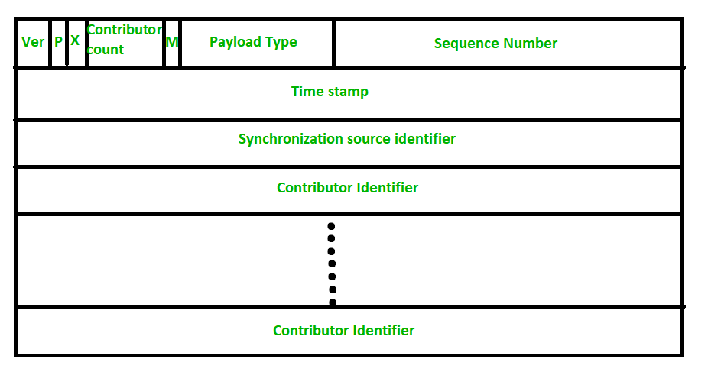
RTP Header Format

Slide 46
Cont..
The header format of RTP is very simple and it covers all real-time applications.
Version : This 2-bit field defines version number. The current version is 2.
P - The length of this field is 1-bit. If value is 1, then it denotes presence of padding at end of packet and if value is 0, then there is no padding.
X - The length of this field is also 1-bit. If value of this field is set to 1, then its indicates an extra extension header between data and basic header and if value is 0 then, there is no extra extension.
Contributor count - This 4-bit field indicates number of contributors. Here maximum possible number of contributor is 15 as a 4-bit field can allows number from 0 to 15.

Slide 47
Cont..
M - The length of this field is 1-bit and it is used as end marker by application to indicate end of its data.
Payload types - This field is of length 7-bit to indicate type of payload. We list applications of some common types of payload.
Sequence Number -
The length of this field is 16 bits. It is used to give serial numbers to RTP packets. It helps in sequencing.
The sequence number for first packet is given a random number and then every next packet’s sequence number is incremented by 1.
This field mainly helps in checking lost packets and order mismatch.

Slide 48
Cont..
Time Stamp -
The length of this field is 32-bit. It is used to find relationship between times of different RTP packets.
The timestamp for first packet is given randomly and then time stamp for next packets given by sum of previous timestamp and time taken to produce first byte of current packet.
The value of 1 clock tick is varying from application to application.
Synchronization Source Identifier -
This is a 32-bit field used to identify and define the source.
The value for this source identifier is a random number that is chosen by source itself.
This mainly helps in solving conflict arises when two sources started with the same sequencing number.

Slide 49
Cont..
Contributor Identifier –
This is also a 32-bit field used for source identification where there is more than one source present in session.
The mixer source use Synchronization source identifier and other remaining sources (maximum 15) use Contributor identifier.

Slide 50
Congestion Control and Quality of Service (QoS)
Congestion control and Quality of Service (QoS) are transport layer concepts that manage network traffic to prevent and mitigate network congestion, ensuring data flows efficiently and reliably.
Congestion control mechanisms, like open-loop prevention and closed-loop feedback, reduce traffic when a network is overloaded by techniques such as Additive Increase Multiplicative Decrease (AIMD).
QoS builds on this by providing different classes of service through techniques like resource reservation and scheduling to guarantee performance levels like bandwidth, delay, and reliability for specific applications.

Slide 51
Congestion Control
Congestion in a computer network happens when there is too much data being sent at the same time, causing the network to slow down.
Just like traffic congestion on a busy road, network congestion leads to delays and sometimes data loss.
When the network can't handle all the incoming data, it gets "clogged," making it difficult for information to travel smoothly from one place to another.
Congestion control is a crucial concept in computer networks.
It refers to the methods used to prevent network overload and ensure smooth data flow.
Congestion control techniques help manage the traffic, so all users can enjoy a stable and efficient network connection.
These techniques are essential for maintaining the performance and reliability of modern networks.

Slide 52
Cont..
What it is:
A set of techniques to manage the amount of data sent over a network to prevent it from becoming overwhelmed, which causes performance degradation, packet loss, and connection failures.
Why it's needed:
When too many hosts send data too quickly, router buffers overflow, causing packets to be dropped. Retransmitting dropped packets exacerbates the problem.

Slide 53
Cont..
How it works:
Open-Loop Control: Prevents congestion before it occurs by using methods at the host, like setting maximum packet rates.
Closed-Loop Control: Responds to congestion that has already occurred.
Implicit Control: The sender infers congestion from events like delayed acknowledgments and implements a timeout.
Explicit Control: Routers send feedback to the sender to signal congestion.
Common Mechanisms:
AIMD (Additive Increase Multiplicative Decrease): A core part of TCP that gradually increases the sending rate and then drastically reduces it when congestion is detected.
Traffic Shaping (e.g., Leaky Bucket and Token Bucket): Traffic is controlled to ensure a steady flow or a consistent average rate.

Slide 54
Effects of Congestion Control
Improved Network Stability:
Congestion control helps keep the network stable by preventing it from getting overloaded.
It manages the flow of data so the network doesn't crash or fail due to too much traffic.
Reduced Latency and Packet Loss:
Without congestion control, data transmission can slow down, causing delays and data loss.
Congestion control helps manage traffic better, reducing these delays and ensuring fewer data packets are lost, making data transfer faster and the network more responsive.

Slide 55
Cont..
Enhanced Throughput:
By avoiding congestion, the network can use its resources more effectively.
This means more data can be sent in a shorter time, which is important for handling large amounts of data and supporting high-speed applications.
Fairness in Resource Allocation:
Congestion control ensures that network resources are shared fairly among users.
No single user or application can take up all the bandwidth, allowing everyone to have a fair share.

Slide 56
Cont..
Better User Experience:
When data flows smoothly and quickly, users have a better experience.
Websites, online services, and applications work more reliably and without annoying delays.
Mitigation of Network Congestion Collapse:
Without congestion control, a sudden spike in data traffic can overwhelm the network, causing severe congestion and making it almost unusable.
Congestion control helps prevent this by managing traffic efficiently and avoiding such critical breakdowns.

Slide 57
Congestion Control Algorithm
Congestion Control is a mechanism that controls the entry of data packets into the network, enabling a better use of a shared network infrastructure and avoiding congestive collapse.
Congestive-avoidance algorithms (CAA) are implemented at the TCP layer as the mechanism to avoid congestive collapse in a network.
There are two congestion control algorithms which are as follows:
1. Leaky Bucket Algorithm
2.Token Bucket Algorithm

Slide 58
Leaky Bucket Algorithm
The leaky bucket algorithm discovers its use in the context of network traffic shaping or rate-limiting.
A leaky bucket execution and a token bucket execution are predominantly used for traffic shaping algorithms.
This algorithm is used to control the rate at which traffic is sent to the network and shape the burst traffic to a steady traffic stream.
The disadvantages compared with the leaky-bucket algorithm are the inefficient use of available network resources.
The large area of network resources such as bandwidth is not being used effectively.

Slide 59
Cont..
Let us consider an example to understand.
Imagine a bucket with a small hole in the bottom.
No matter at what rate water enters the bucket, the outflow is at constant rate.
When the bucket is full with water additional water entering spills over the sides and is lost.

Slide 60
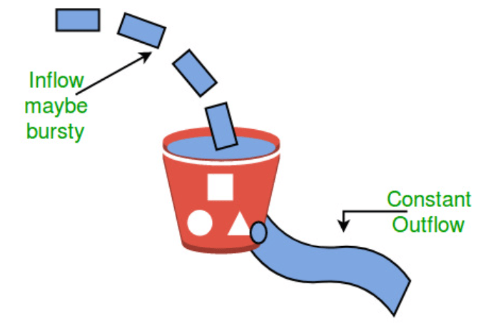

Slide 61
Cont..
Similarly, each network interface contains a leaky bucket and the following steps are involved in leaky bucket algorithm:
When host wants to send packet, packet is thrown into the bucket.
The bucket leaks at a constant rate, meaning the network interface transmits packets at a constant rate.
Bursty traffic is converted to a uniform traffic by the leaky bucket.
In practice the bucket is a finite queue that outputs at a finite rate.

Slide 62
Token Bucket Algorithm
The leaky bucket algorithm has a rigid output design at an average rate independent of the bursty traffic.
In some applications, when large bursts arrive, the output is allowed to speed up.
This calls for a more flexible algorithm, preferably one that never loses information.
Therefore, a token bucket algorithm finds its uses in network traffic shaping or rate-limiting.
It is a control algorithm that indicates when traffic should be sent. This order comes based on the display of tokens in the bucket.
The bucket contains tokens. Each of the tokens defines a packet of predetermined size.
Tokens in the bucket are deleted for the ability to share a packet.
When tokens are shown, a flow to transmit traffic appears in the display of tokens.
No token means no flow sends its packets. Hence, a flow transfers traffic up to its peak burst rate in good tokens in the bucket.

Slide 63
Need of Token Bucket Algorithm
The leaky bucket algorithm enforces output pattern at the average rate, no matter how bursty the traffic is.
So in order to deal with the bursty traffic we need a flexible algorithm so that the data is not lost.
One such algorithm is token bucket algorithm.
Steps of this algorithm can be described as follows:
In regular intervals tokens are thrown into the bucket.
The bucket has a maximum capacity.
If there is a ready packet, a token is removed from the bucket, and the packet is sent.
If there is no token in the bucket, the packet cannot be sent.

Slide 64
Token Bucket vs Leaky Bucket
The leaky bucket algorithm controls the rate at which the packets are introduced in the network, but it is very conservative in nature.
Some flexibility is introduced in the token bucket algorithm.
In the token bucket algorithm, tokens are generated at each tick (up to a certain limit).
For an incoming packet to be transmitted, it must capture a token and the transmission takes place at the same rate.
Hence some of the busty packets are transmitted at the same rate if tokens are available and thus introduces some amount of flexibility in the system.

Slide 65
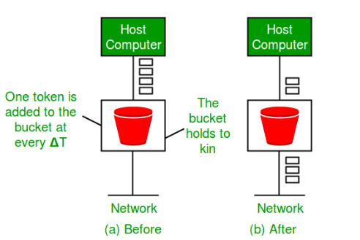

Slide 66
Advantages
Stable Network Operation: Congestion control ensures that networks remain stable and operational by preventing them from becoming overloaded with too much data traffic.
Reduced Delays: It minimizes delays in data transmission by managing traffic flow effectively, ensuring that data packets reach their destinations promptly.
Less Data Loss: By regulating the amount of data in the network at any given time, congestion control reduces the likelihood of data packets being lost or discarded.
Optimal Resource Utilization: It helps networks use their resources efficiently, allowing for better throughput and ensuring that users can access data and services without interruptions.

Slide 67
Cont..
Scalability: Congestion control mechanisms are scalable, allowing networks to handle increasing volumes of data traffic as they grow without compromising performance.
Adaptability: Modern congestion control algorithms can adapt to changing network conditions, ensuring optimal performance even in dynamic and unpredictable environments.

Slide 68
Disadvantages
Complexity: Implementing congestion control algorithms can add complexity to network management, requiring sophisticated systems and configurations.
Overhead: Some congestion control techniques introduce additional overhead, which can consume network resources and affect overall performance.
Algorithm Sensitivity: The effectiveness of congestion control algorithms can be sensitive to network conditions and configurations, requiring fine-tuning for optimal performance.
Resource Allocation Issues: Fairness in resource allocation, while a benefit, can also pose challenges when trying to prioritize critical applications over less essential ones.
Dependency on Network Infrastructure: Congestion control relies on the underlying network infrastructure and may be less effective in environments with outdated or unreliable equipment.

Slide 69
Quality of Service (QoS)
Quality of Service (QoS) is a set of network technologies that manage and prioritize data traffic to ensure the performance of critical applications by controlling factors like delay, jitter (delay variation), packet loss, and bandwidth.
To improve QoS, network administrators use methods such as packet marking, which identifies traffic types (voice, video, data); virtual queuing to create separate queues for different priorities; traffic shaping to control data flow rates; bandwidth allocation to reserve resources; and admission control to manage network capacity.

Slide 70
What is Quality of Service (QoS)?
QoS refers to the techniques and technologies used in computer networks to manage network traffic and ensure predictable performance for specific applications.
It focuses on improving the overall user experience by preventing network congestion and performance degradation. The key characteristics that QoS aims to control are:
Reliability:
Ensuring data is delivered without loss or significant errors.
Delay:
Minimizing the time it takes for data packets to travel from sender to receiver.
Jitter:
Reducing the variation in delay between packets to maintain smooth audio and video streams.
Bandwidth:
Managing the amount of data that can be transferred within a given time, which is crucial for high-demand applications.

Slide 71
Methods to Improve QoS
Packet Marking:
This process assigns a priority tag to data packets, differentiating critical traffic (like voice and video) from less important data.
Virtual Queues (or Queuing):
Routers create separate, virtual queues for different types of traffic. Critical applications receive reserved bandwidth and preferential treatment in these queues, ensuring they get processed first.
Traffic Shaping:
This method controls the rate at which data packets are sent into the network. It helps to smooth out traffic bursts, preventing congestion and reducing delay.

Slide 72
Cont..
Bandwidth Allocation:
Specific portions of the network's bandwidth are reserved for certain applications or services. This guarantees that essential services have the resources they need, even when the network is busy.
Resource Reservation:
This involves reserving network resources, such as bandwidth and processing power, for specific flows of data.
Admission Control:
A mechanism to control the amount of traffic entering the network. It ensures that new traffic flows do not exceed the network's capacity, preventing overload and maintaining service quality for existing flows.

Slide 73
TCP and UDP for wireless network
TCP and UDP can both be used over wireless networks, but the choice depends on application requirements.
TCP (Transmission Control Protocol) offers reliable, ordered, and error-checked data delivery, ideal for applications where accuracy is paramount, like web browsing and email.
UDP (User Datagram Protocol) provides fast, connectionless transmission with low overhead, but without guaranteed delivery, making it suitable for real-time applications like video streaming and online gaming where speed and low latency are prioritized.

Slide 74
When to Use TCP on a Wireless Network
Data Integrity is Critical:
TCP ensures that all data packets are received in the correct order and without errors, which is crucial for applications like file transfers, secure data transfers, and sending emails.
Reliable Connection Needed:
TCP establishes a connection before data transmission, maintaining a stable flow and retransmitting lost packets, ensuring that the application has complete and accurate information.

Slide 75
When to Use UDP on a Wireless Network
Speed and Low Latency Are Key:
UDP's connectionless nature reduces overhead, resulting in faster data transmission and lower latency, which is essential for real-time applications like live broadcasts, voice calls (VoIP), and online gaming.
Application Tolerates Data Loss:
Since UDP does not guarantee delivery or order, applications using it must be designed to handle potential data loss or out-of-order packets.
Efficient for Broadcasts:
UDP is well-suited for broadcasting and multicast transmissions because it does not need to establish a connection with every recipient.

Slide 76
Challenges for TCP and UDP on Wireless Networks
Performance Issues:
Both TCP and UDP can encounter performance issues over wireless networks due to factors like varying radio hardware, device drivers, and network congestion.
Packet Loss in Wireless Environments:
Wireless networks are inherently prone to packet loss, which can significantly impact TCP's performance because it may attempt to retransmit packets excessively, while applications relying on UDP must already be prepared for this loss.
Bandwidth Management:
Managing the shared bandwidth between the more aggressive but reliable TCP and the faster UDP can be challenging, with some networks employing TCP acceleration techniques to optimize performance.

Slide 77
Challenges for TCP and UDP on Wireless Networks
Performance Issues:
Both TCP and UDP can encounter performance issues over wireless networks due to factors like varying radio hardware, device drivers, and network congestion.
Packet Loss in Wireless Environments:
Wireless networks are inherently prone to packet loss, which can significantly impact TCP's performance because it may attempt to retransmit packets excessively, while applications relying on UDP must already be prepared for this loss.
Bandwidth Management:
Managing the shared bandwidth between the more aggressive but reliable TCP and the faster UDP can be challenging, with some networks employing TCP acceleration techniques to optimize performance.

Slide 78
Socket in Computer Networks
A socket is one endpoint of a two way communication link between two programs running on the network.
The socket mechanism provides a means of inter-process communication (IPC) by establishing named contact points between which the communication take place.
In computer networks, a socket is a software endpoint for two-way communication between applications, analogous to a door for sending and receiving data over a network.
It uniquely identifies an application by combining a machine's IP address and a port number.
Sockets are essential for inter-process communication and are heavily used in client-server architectures, enabling programs to send and receive data reliably or unreliably over the network using various protocols like TCP or UDP.

Slide 79
How Sockets Work
A socket connecting to the network is created at each end of the communication.
Each socket has a specific address.
This address is composed of an IP address and a port number.
Socket are generally employed in client server applications.
The server creates a socket, attaches it to a network port addresses then waits for the client to contact it.
The client creates a socket and then attempts to connect to the server socket.
When the connection is established, transfer of data takes place.

Slide 80
Cont..
Creation: A socket is created by an application, typically using a system call provided by the operating system.
Binding: The socket is bound to a specific IP address and port number, which act as its address on the network.
Connection (for TCP): In client-server communication, the server creates a socket and listens on a port, while the client creates its own socket and attempts to connect to the server's address and port.
Data Transfer: Once a connection is established, data can be sent and received by reading from or writing to the connected sockets.
Closure: The communication link remains active until the socket is closed by either the client or the server.

Slide 81
Analogy to a Phone System
IP Address: Like a street address, it identifies the specific device (computer) on the network.
Port Number: Like a specific phone number within that building, it directs the data to the correct application or service on the device.
Socket: The combination of the IP address and port number acts as the specific phone line for communication between applications.

Slide 82
Key Characteristics
Bidirectional: Sockets provide a two-way channel for data flow.
Abstraction: They offer an API (Application Programming Interface) that abstracts the complexities of network protocols, making it easier for developers to implement network communication.
Inter-Process Communication (IPC): They facilitate communication between processes, whether they are on the same machine or different machines across a network.

Slide 83
Types of Sockets
Datagram Socket : This is a type of network which has connection less point for sending and receiving packets.
It is similar to mailbox. The letters (data) posted into the box are collected and delivered (transmitted) to a letterbox (receiving socket).
Stream Socket:
In Computer operating system, a stream socket is type of interprocess communications socket or network socket which provides a connection-oriented, sequenced, and unique flow of data without record boundaries with well defined mechanisms for creating and destroying connections and for detecting errors.
It is similar to phone.
A connection is established between the phones (two ends) and a conversation (transfer of data) takes place.

Slide 84
Common Function Calls in Socket Programming
Function Call | Description
Socket() | To create a socket
Bind() | It's a socket identification like a telephone number to contact
Listen() | Ready to receive a connection
Connect() | Ready to act as a sender
Accept() | Confirmation, it is like accepting to receive a call from a sender
Write() | To send data
Read() | To receive data
Close() | To close a connection

